Slide 1

HE3001 Microeconomics 3
Introduction to the course

Slide 2
Course Aims
In this course, we will be examining contexts with less than “perfect” settings.
Basics of game theory and strategic decision making.
Markets under asymmetric information.
Markets with Externalities.
Non-standard decision making.
Important background for all other field courses!

Slide 3
Course Content
Week
1 | Lecture 1: Game Theory 1
2 | Lecture 2: Game Theory 2
3 | Lecture 3: Game Theory 3
4 | Lecture 4: Adverse selection, Signaling
5 | Lecture 5: Moral Hazard, Contract Theory
6 | Lecture 6: Auctions
7 | Bi-semester Test 1
Recess Week | Recess Week
8 | Lecture 7: Externalities
9 | Lecture 8: Public Goods, Common Property
10 | Lecture 9: Information Technology 1
11 | Deepavali Holiday
12 | Lecture 10: Information Technology 2
13 | Behavioural Economics/ Revision
14 | Bi-semester Test 2
Strategic Interactions, Simple Analysis
Markets under Imperfect, Incomplete Information.
Markets with Externalities
Non-Standard Decision Making

Slide 4

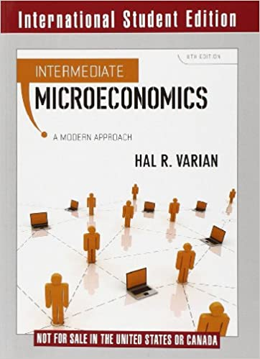
Textbook
Course material is derived from: Intermediate Microeconomics: A Modern Approach, 9th Edition by H.R. Varian. W.W.Norton & Company.
Any later editions should suffice.
Game theory lectures also have extra material not in the textbook.

Slide 5

Lectures
In lectures, we will be going through general theory and methods using worked examples.
Make sure that you understand these fundamentals very well!
Economic intuition behind the (mathematical) equations.
Don’t just memorise the steps!
This will allow you to apply the understanding to other similar and more complex situations.
Feel free to raise questions you may have at any point. If you are shy, you can also ask during the breaks.

Slide 6
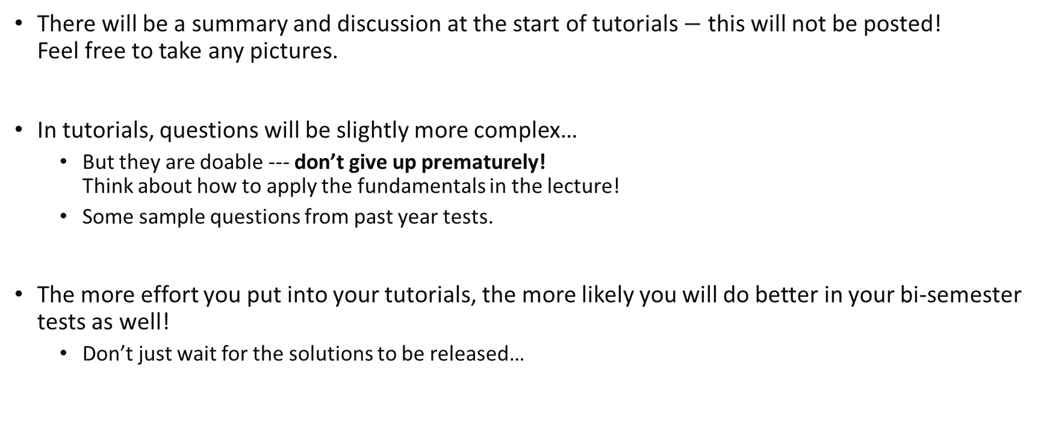
Tutorials
There will be a summary and discussion at the start of tutorials $−$ this will not be posted! Feel free to take any pictures.
In tutorials, questions will be slightly more complex…
But they are doable --- don’t give up prematurely! Think about how to apply the fundamentals in the lecture!
Some sample questions from past year tests.
The more effort you put into your tutorials, the more likely you will do better in your bi-semester tests as well!
Don’t just wait for the solutions to be released…

Slide 7
Learning outcomes
Use microeconomics concepts and theories to describe individual and social choice under strategic interactions and imperfect market settings.
Apply fundamental microeconomic models to analyse decision-making by agents in these contexts and the impacts on efficiency and social welfare.
Identify and understand the possible solutions to problems created by the strategic/imperfect nature of the decision context.
Communicate economic reasoning, in speech and writing to explain and evaluate the different processes behind agents’ decisions, how they affect efficiency and policy solutions.

Slide 8
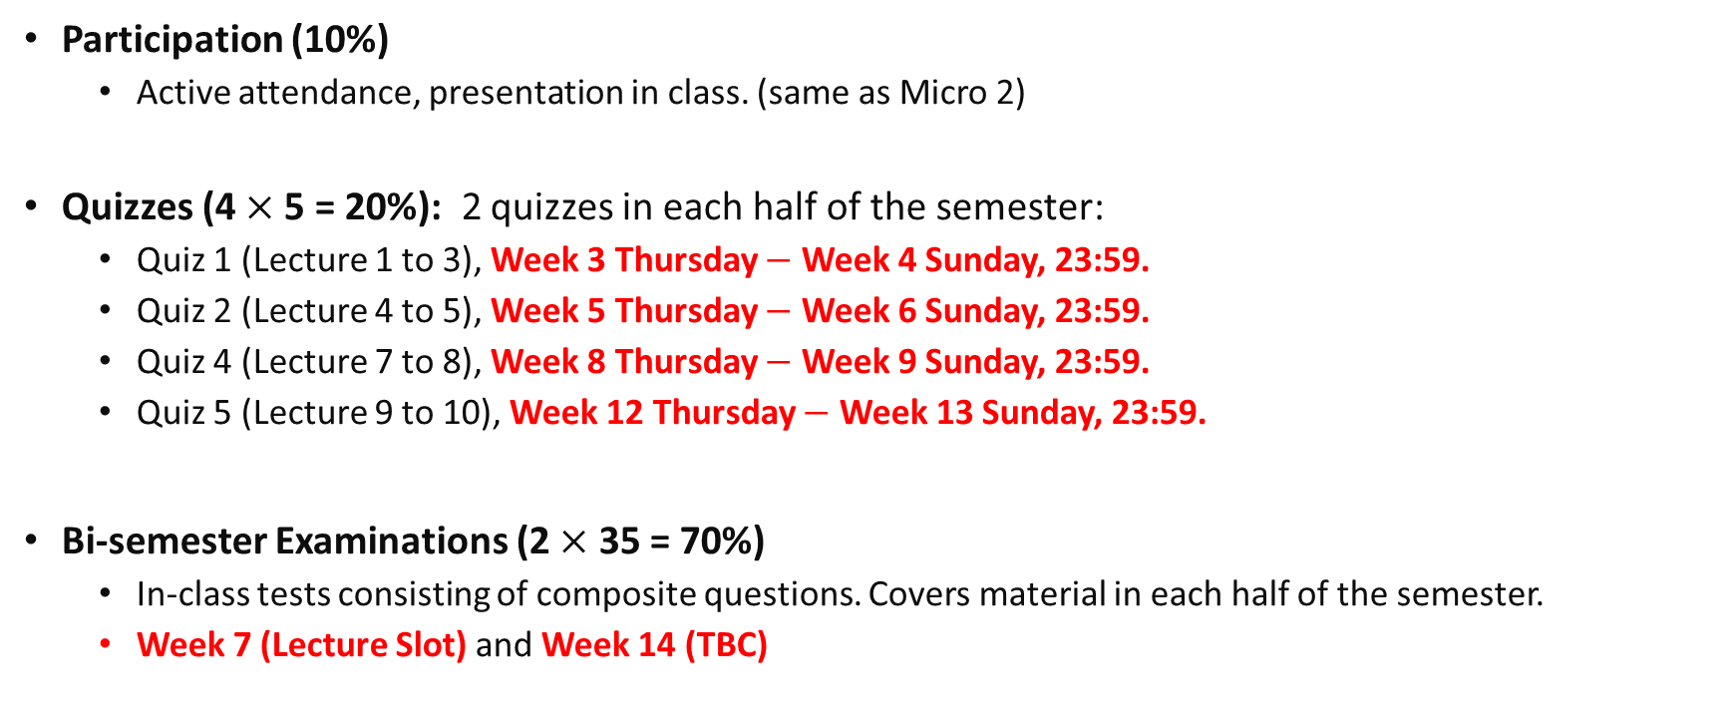
Assessment
Participation (10%)
Active attendance, presentation in class. (same as Micro 2)
Quizzes (4$×$ 5 = 20%): 2 quizzes in each half of the semester:
Quiz 1 (Lecture 1 to 3), Week 3 Thursday $−$ Week 4 Sunday, 23:59.
Quiz 2 (Lecture 4 to 5), Week 5 Thursday $−$ Week 6 Sunday, 23:59.
Quiz 4 (Lecture 7 to 8), Week 8 Thursday $−$ Week 9 Sunday, 23:59.
Quiz 5 (Lecture 9 to 10), Week 12 Thursday $−$ Week 13 Sunday, 23:59.
Bi-semester Examinations (2 $×$ 35 = 70%)
In-class tests consisting of composite questions. Covers material in each half of the semester.
Week 7 (Lecture Slot) and Week 14 (TBC)
Notes:
With regards to assessments for tests and tutorials, as in HE1001, I would expect you to not only be able to derive mathematically answers to questions, but also be able to explain the economic reasoning behind them as in our learning outcomes.

Slide 9
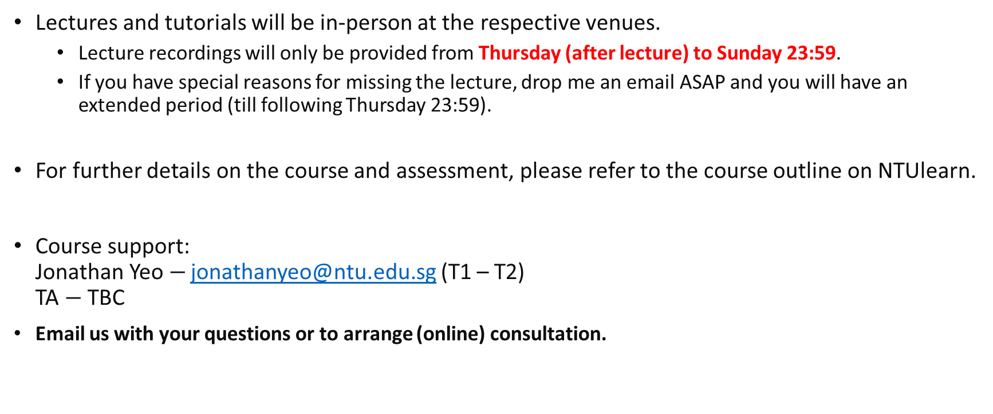
Course Policies and Contact
Lectures and tutorials will be in-person at the respective venues.
Lecture recordings will only be provided from Thursday (after lecture) to Sunday 23:59.
If you have special reasons for missing the lecture, drop me an email ASAP and you will have an extended period (till following Thursday 23:59).
For further details on the course and assessment, please refer to the course outline on NTUlearn.
Course support: Jonathan Yeo $−$ jonathanyeo@ntu.edu.sg (T1 – T2) TA $−$ TBC
Email us with your questions or to arrange (online) consultation.

